Slide 1
Spectre
Joren Janzing

Slide 2
Content
Comparison with Alessandro:
Coherence Spectra
Time Series
Along trough cross section
PCA animations

Slide 3
Coherence Spectrum following Alessandro

Slide 4
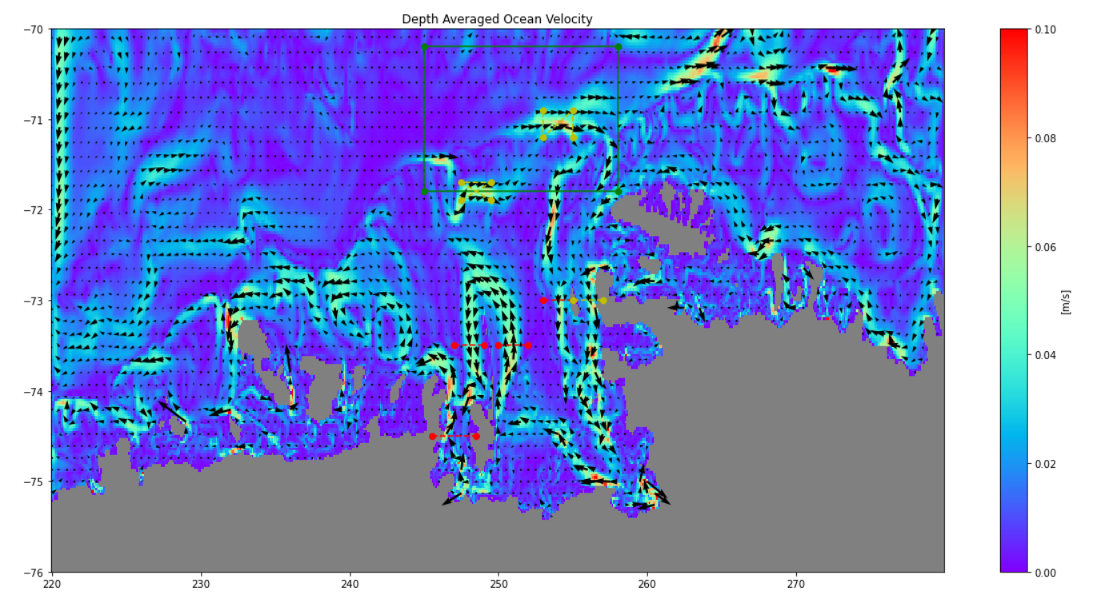
Method
Shelf Break
Bottom Box
PITE

Slide 5
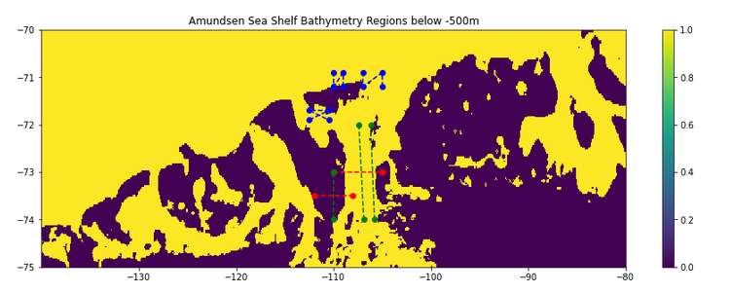

Slide 6
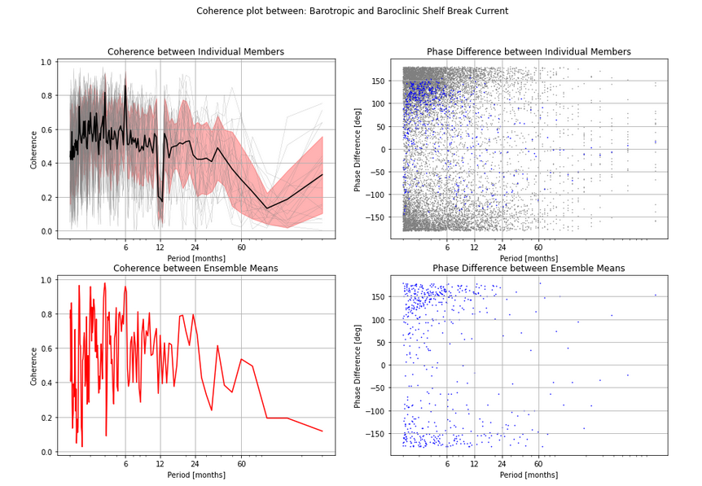
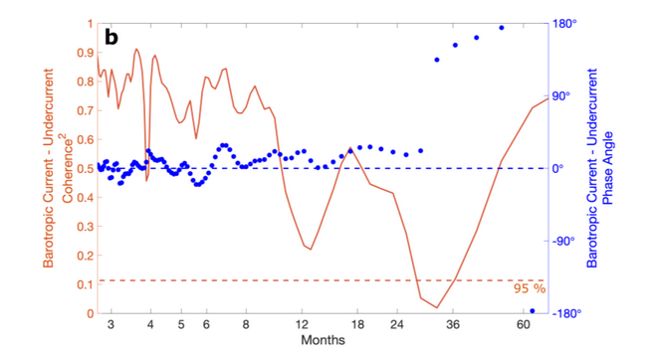
Silvano,concept

Slide 7
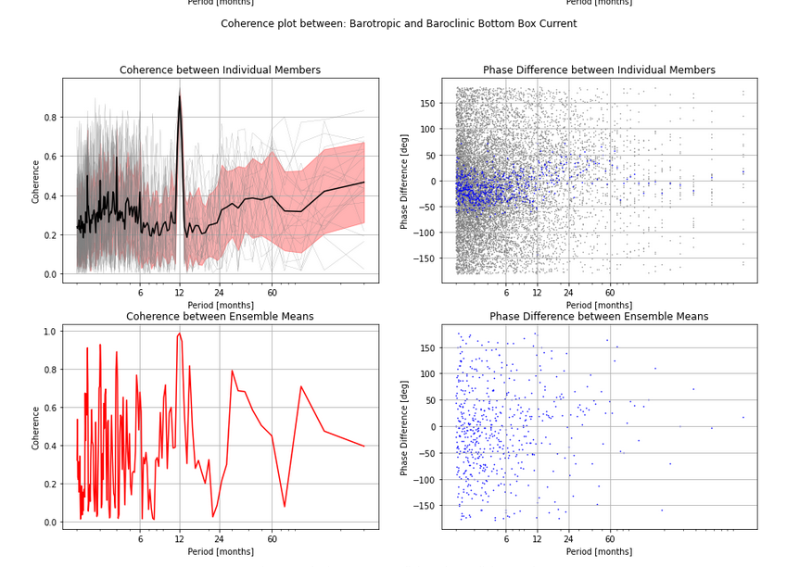
Silvano,concept

Slide 8
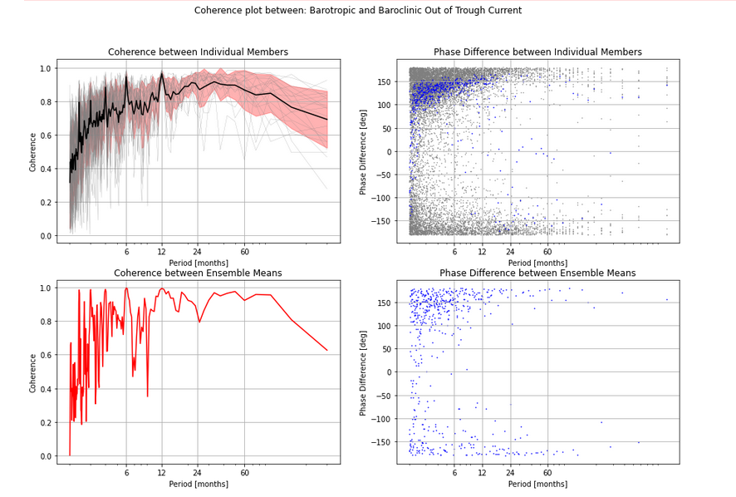
Silvano,concept

Slide 9
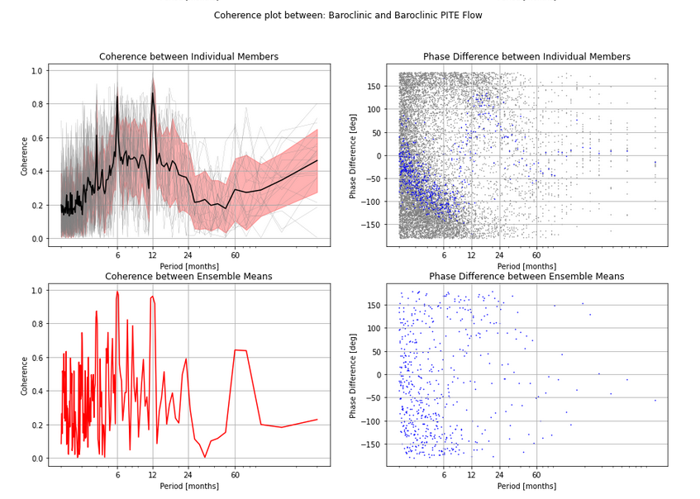
Silvano,concept

Slide 10
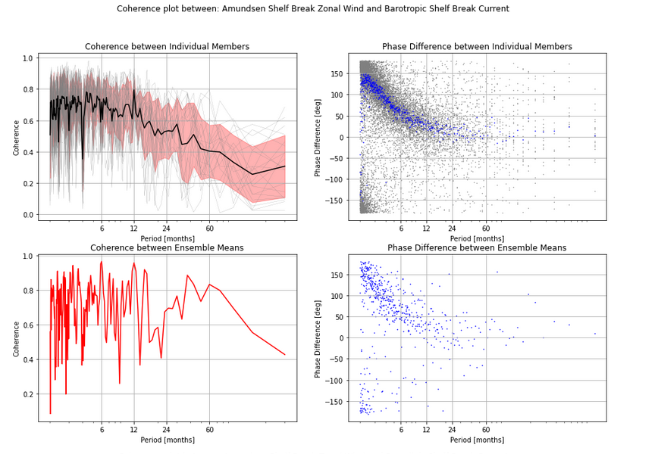

Slide 11
Conclusion
Differences between Alessandro and my results: - Different physical definition of undercurrent? - Different regional definition?

Slide 12
Time Series following Alessandro
Method:
Remove 25 year running mean.
First, Ensemble Mean

Slide 13
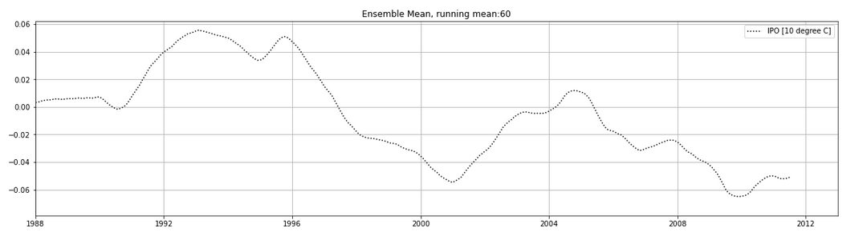
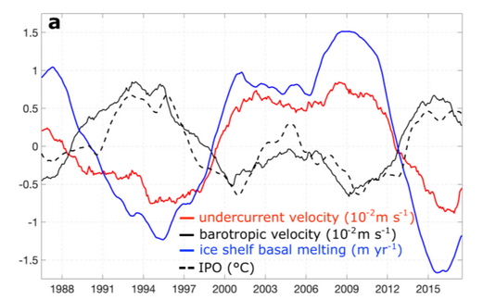
Silvano,concept

Slide 14
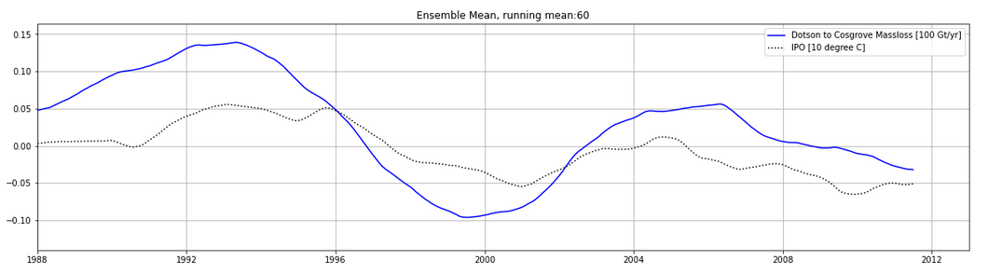
Silvano,concept

Slide 15
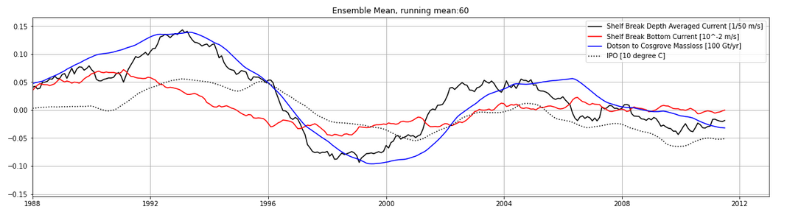
Silvano,concept

Slide 16
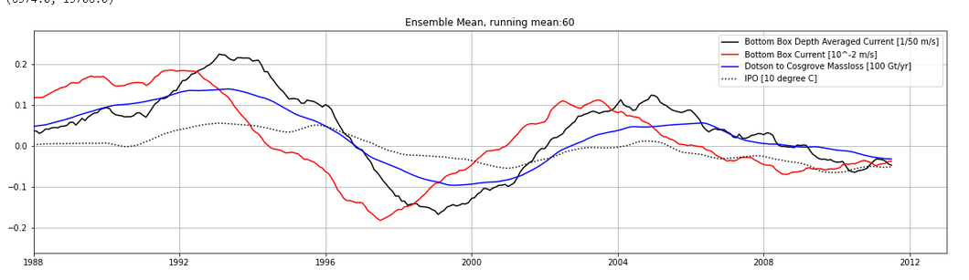
Silvano,concept

Slide 17
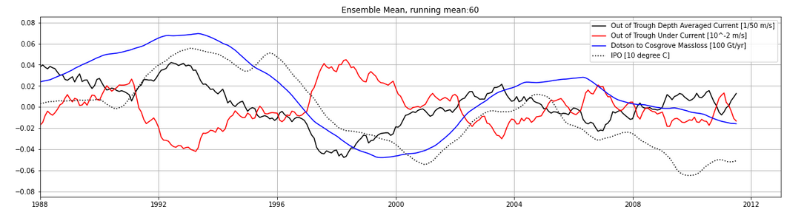
Silvano,concept

Slide 18
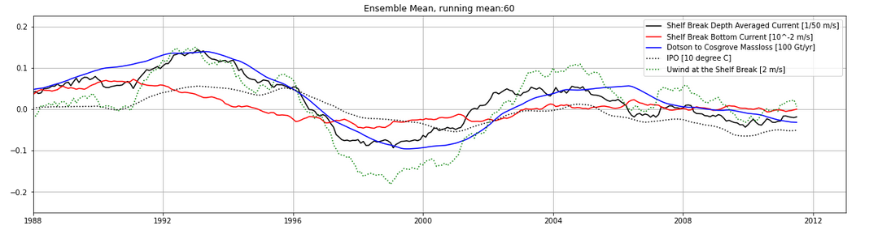
Silvano,concept

Slide 19
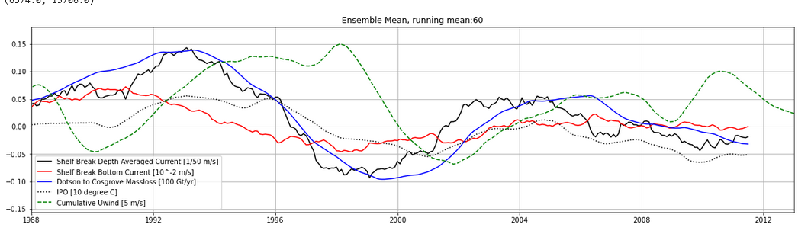
Silvano,concept

Slide 20
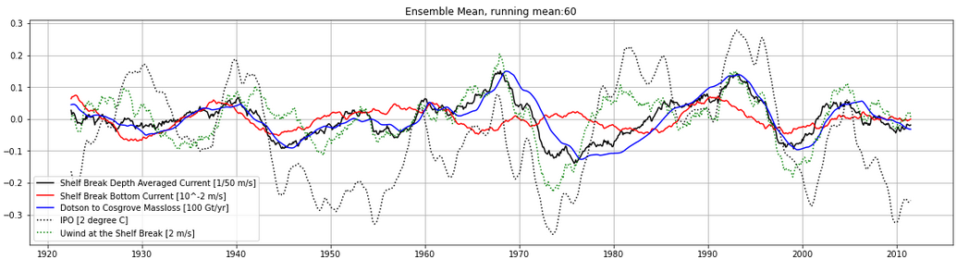
At other times:
There are some occasions when bottom current is oposite to barotropic current.
However: barotropic currents seems to be more in line with the melt!

Slide 21
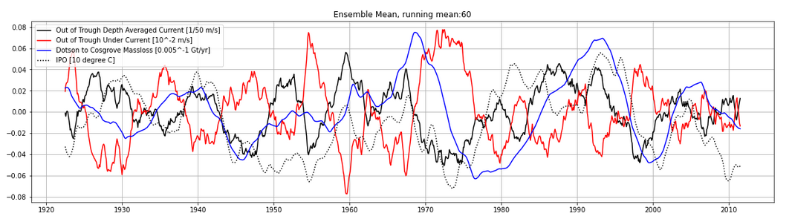

Slide 22
Time Series following Alessandro
Now, Ensemble Member that is more like Alessandro’s

Slide 23
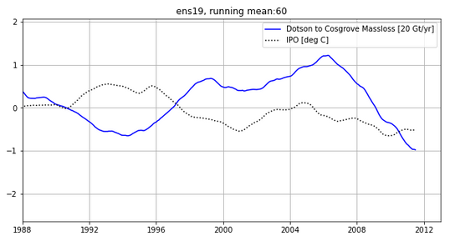
Silvano,concept

Slide 24
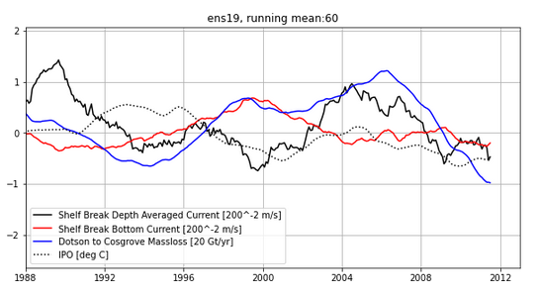
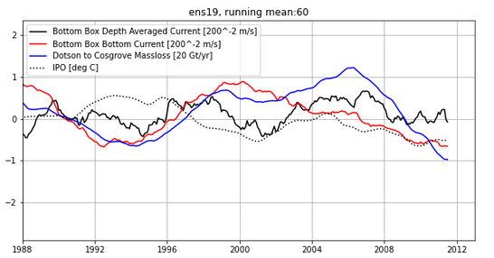
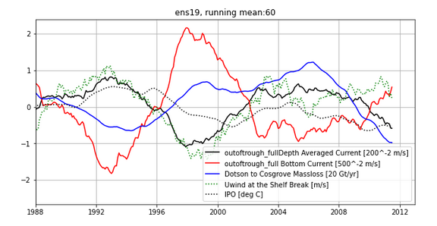
Silvano,concept

Slide 25
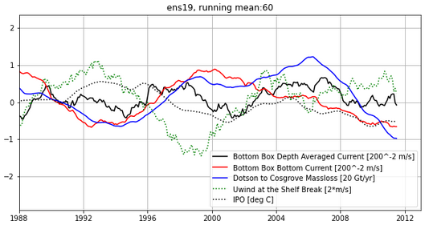

Slide 26
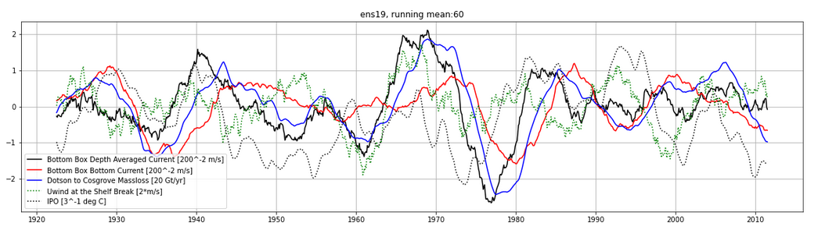

Slide 27
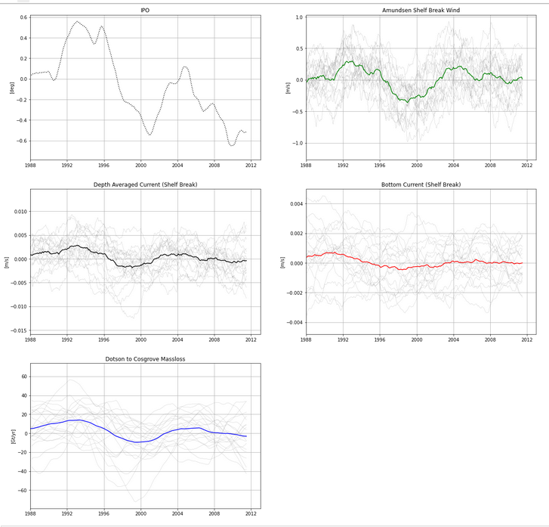

Slide 28
Conclusion
In general, mechanism that Alessandro shows is not widely present in our dataset.
It seems that in most cases the bottom current and the barotropic current follow eachother roughly.
When they don’t, it is often the barotropic current that is more aligned with the th
Strong noise
Problem: different region of undercurrent? Still, melt seems to follow the IPO better

Slide 30
Along Trough Cross Section

Slide 31
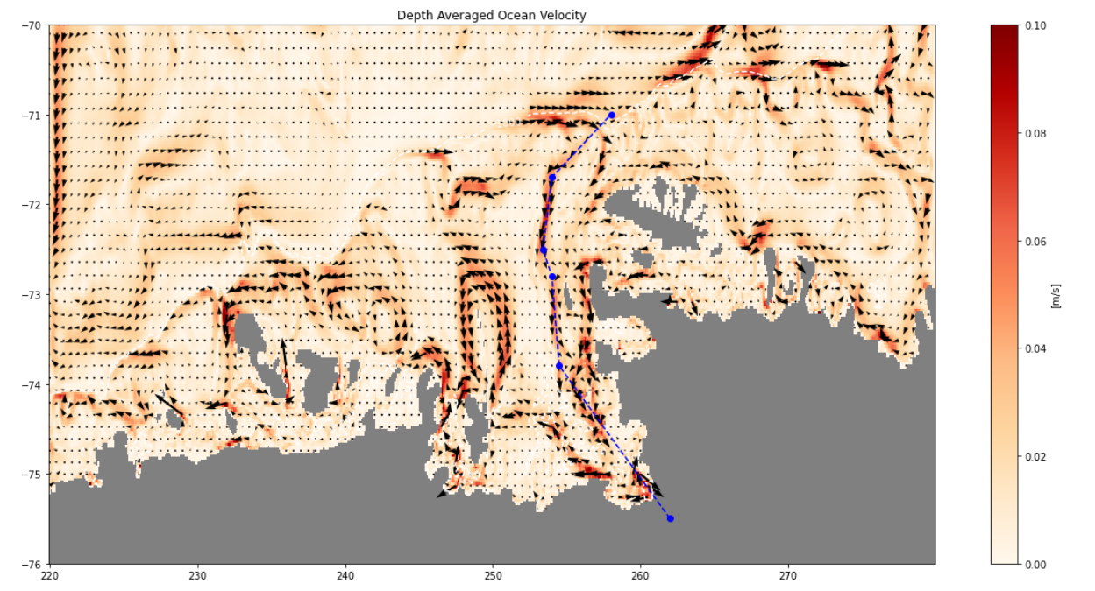

Slide 32
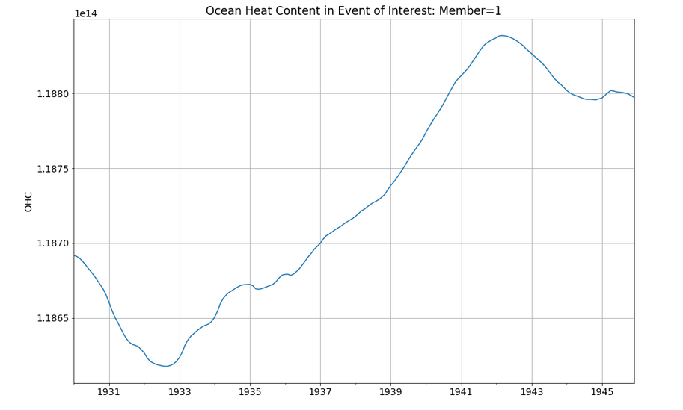

Slide 33
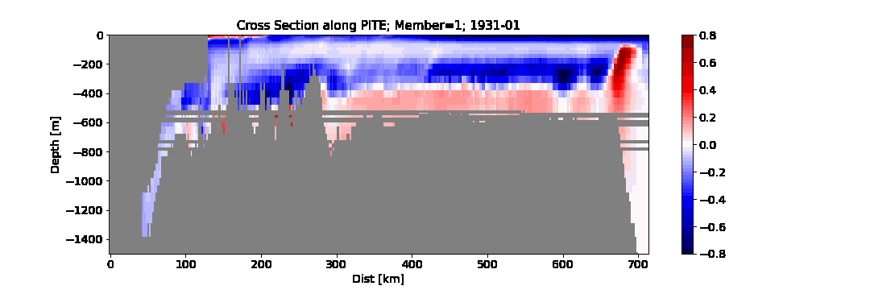

Slide 34
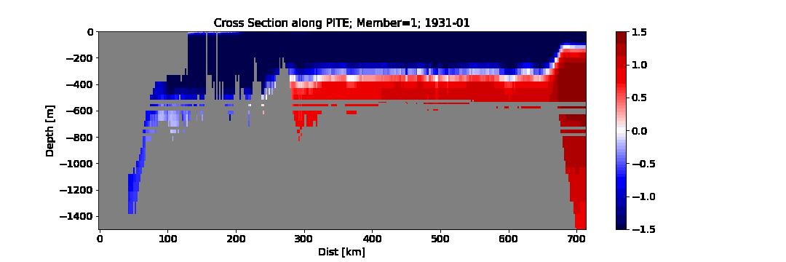

Slide 35
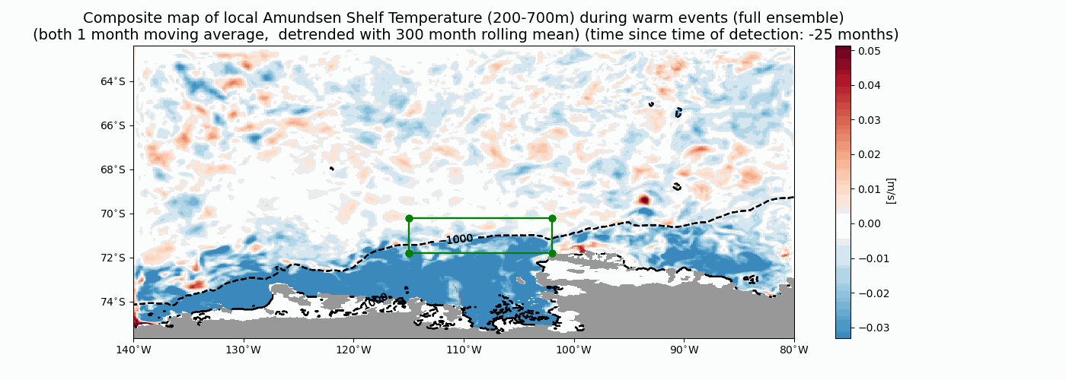

Slide 36
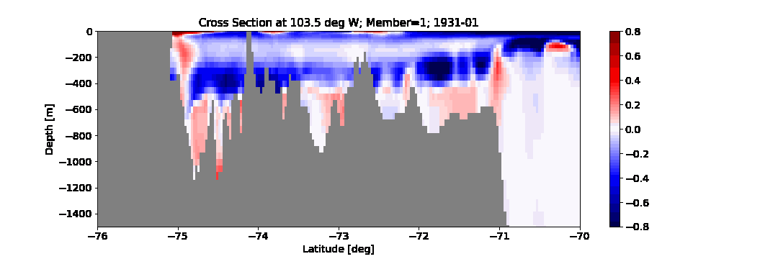

Slide 37
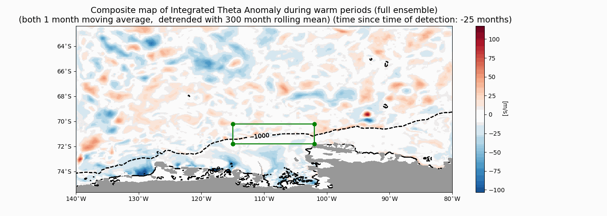

Slide 38
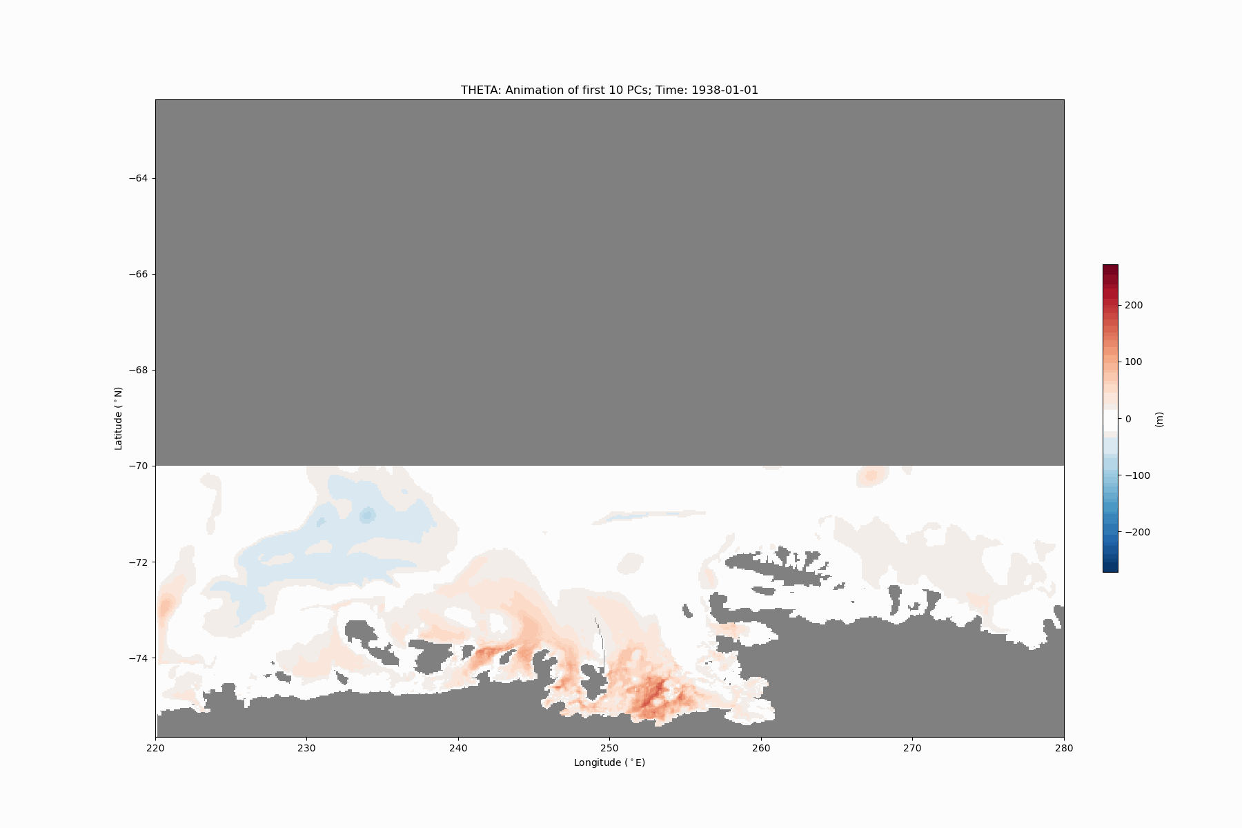
PCA animation

Slide 40
Extra

Slide 41
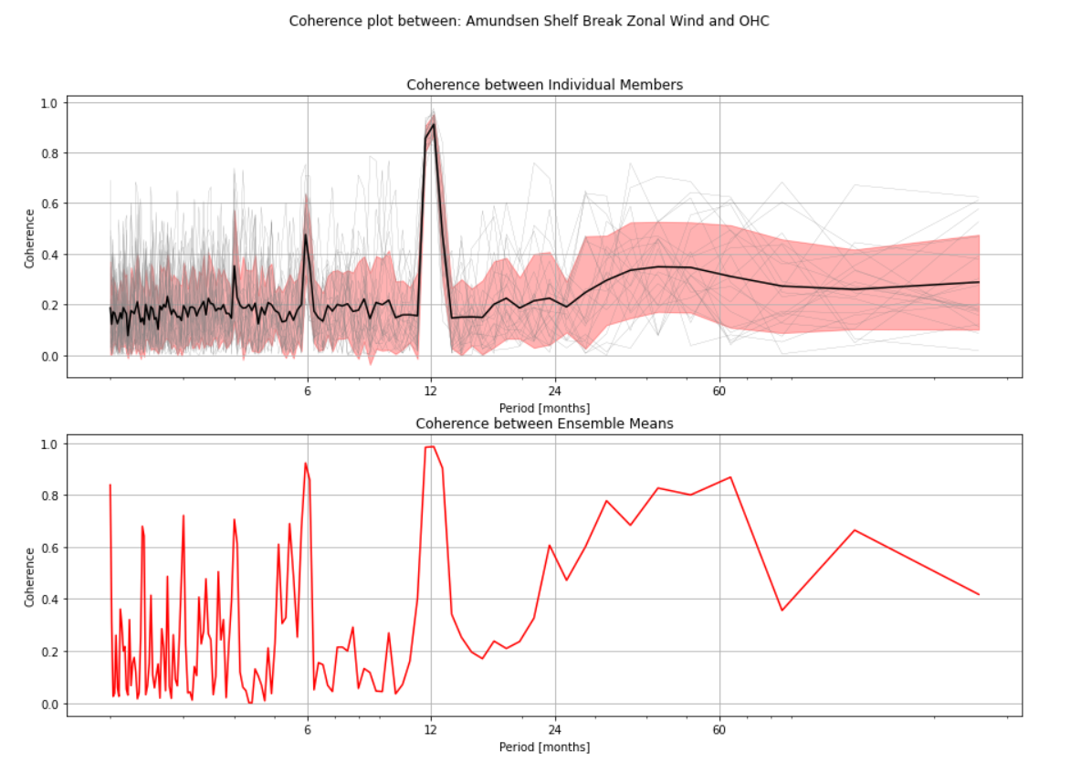

Slide 42
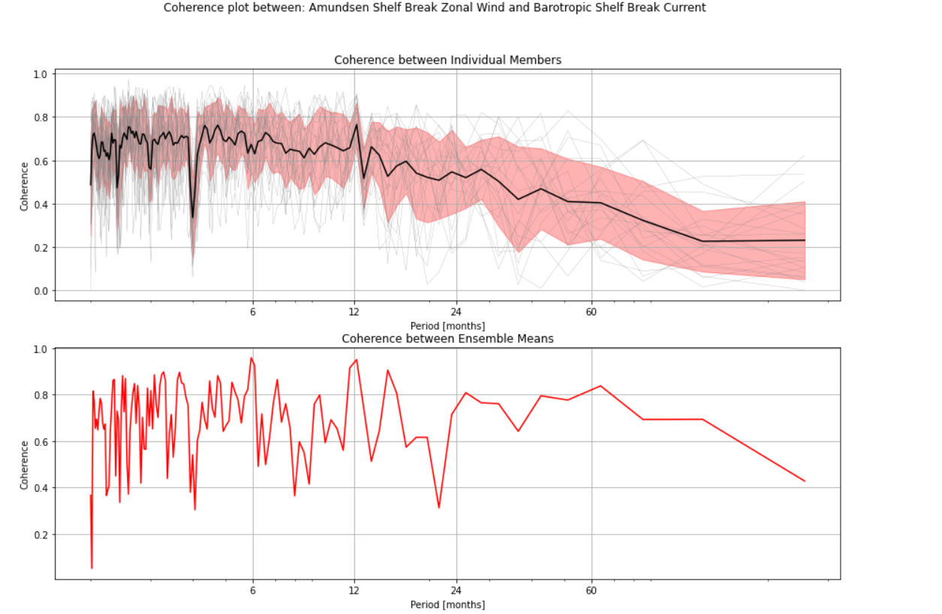

Slide 43
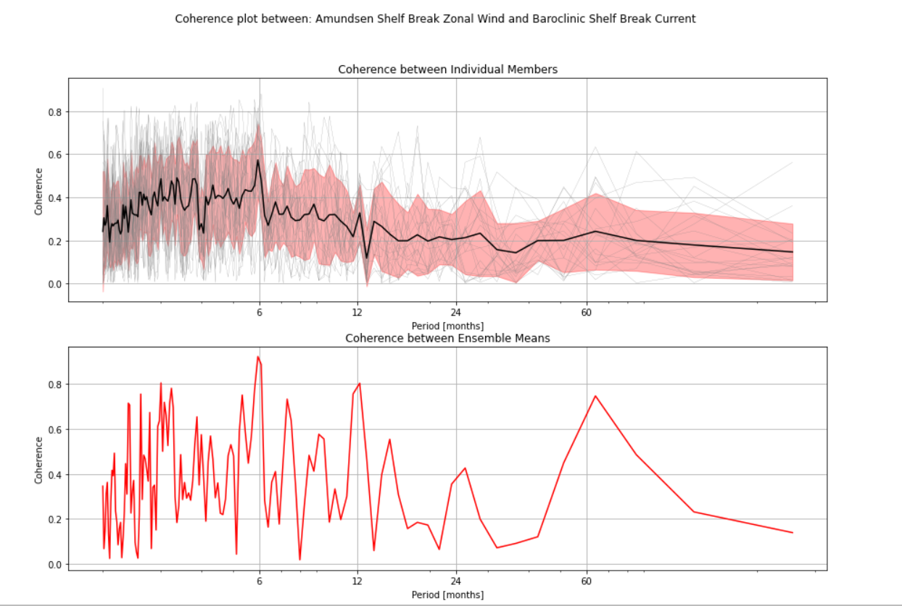

Slide 44
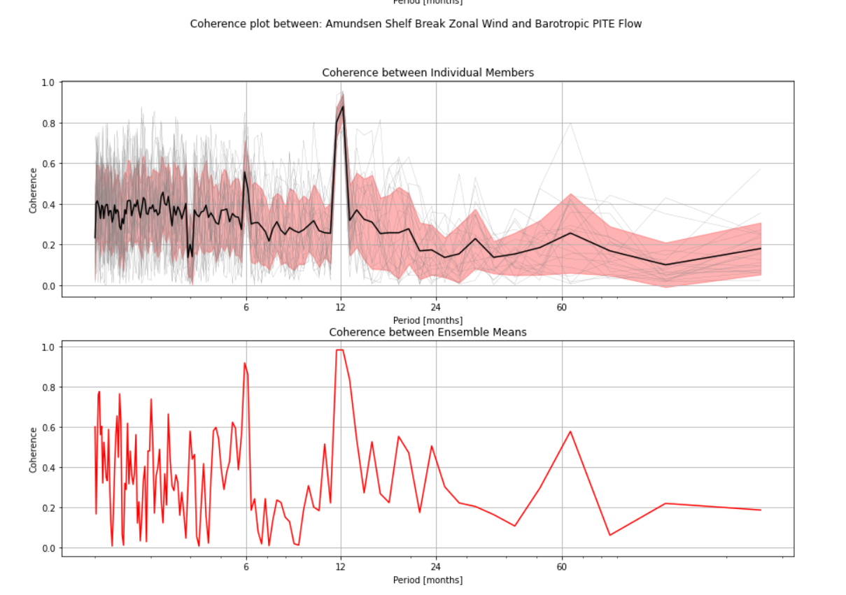

Slide 45
